Slide 1
Module-05
Hashing

Slide 2
Hashing
Hashing is a fundamental data structure that efficiently stores and retrieves data in a way that allows for quick access.
It involves mapping data to a specific index in a hash table using a hash function, enabling fast retrieval of information based on its key.
This method is commonly used in databases, caching systems, and various programming applications to optimize search and retrieval operations.

Slide 3
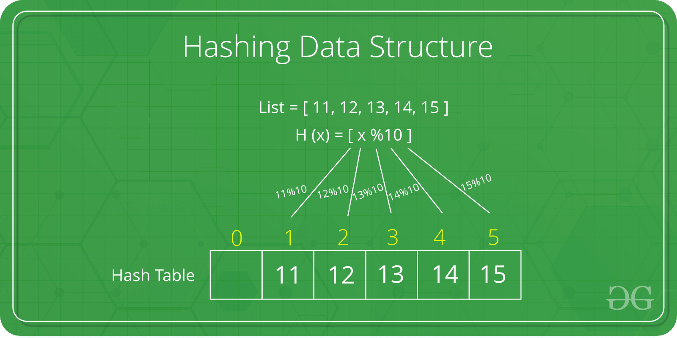

Slide 4
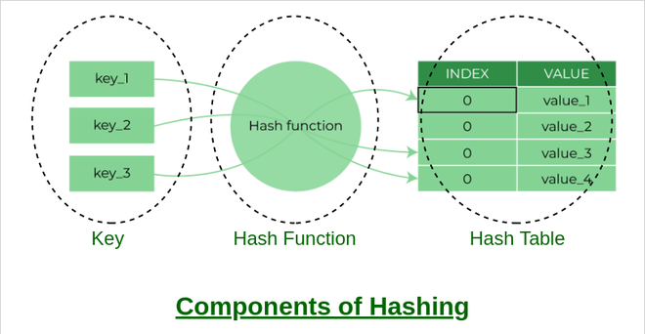
Components

Slide 5
Hash function
The hash function creates a mapping between key and value, this is done through the use of mathematical formulas known as hash functions.
The result of the hash function is referred to as a hash value or hash.

Slide 6
Types of Hash functions:
There are many hash functions that use numeric or alphanumeric keys.
Division Method.
Mid Square Method
Folding Method.
Multiplication Method

Slide 7
What is Collision?
Since a hash function gets us a small number for a key which is a big integer or string, there is a possibility that two keys result in the same value.
The situation where a newly inserted key maps to an already occupied slot in the hash table is called collision and must be handled using some collision handling technique.

Slide 8
Overflow addressing (Collision)
Chaining method
Open addressing methods (linear probing, Quadratic probing, Double hashing)

Slide 9
Dynamic hashing
Dynamic hashing is a method of hashing in which the data structure grows and shrinks dynamically as records are added or removed.
Dynamic hashing (Extended hashing)
In DH method use directories and buckets are used to hash the data.
It is a flexible method in which the hash function also experiences dynamic change.

Slide 10
Directories – The Directories store addresses of the buckets in pointer and it is assigned to each directory, it may change each time, when directory expansion takes place.
Buckets- The Buckets are used to hash the actual data.

Slide 11
